Slide 1

Office of Emerging Frontiers and
Multidisciplinary Activities (EFMA)
Alias Smith, Program Director (ENG/EFMA)
alismith@nsf.gov

Slide 2
FY24 Activities: Emerging Frontiers and Multidisciplinary Activities (EFMA) Office
  EFRI FY24/25 Topic: Biocomputing through EnGINeering Organoid Intelligence (BEGIN OI)
        NSF 24-508
  NSF Trailblazer Engineering Impact Award (TRAILBLAZER)
        NSF 23-629
  Ideas Lab: Personalized Engineering Learning (PEL)
        NSF 23-629
Notes:
This is an alternate slide, because it’s looking more and more like the EFRI solicitation won’t be out by next Monday.

Slide 3
The Emerging Frontiers in Research & Innovation (EFRI) Program
  The EFRI Program serves a critical role in helping the Engineering Directorate to focus on important emerging areas in a timely manner.
  Community Driven – Engages the research community (through a DCL) as well as NSF Program Directors to identify and fund a portfolio of projects in strategic emerging, interdisciplinary areas that may not be supported through current NSF programs, and in which ENG research plays the leading role.
  Uses Potentially Transformative / High risk, High reward and Interdisciplinary as criteria for project selection.
  Signature midscale project-funding mechanism in ENG ($2M / 4 year projects)

Slide 4
  FY07 ARES: Autonomously Reconfigurable Engineered Systems
  CBE: Cellular and Biomolecular Engineering
  FY08 COPN: Cognitive Optimization and Prediction
  RESIN: Resilient and Sustainable Infrastructures
  FY09 BSBA: Biosensing and Bioactuation
  HyBi: Hydrocarbons from Biomass
  FY10 SEED: Science in Energy and Environmental Design
  RESTOR: Renewable Energy Storage
  FY11 M3C: Mind, Machines, and Motor Control
  MIKS: Engineering based on Multicellular and Interkingdom Signaling
  FY12/13 BioFlex: Flexible Bioelectronics Systems
  PSBR: Photosynthetic Biorefineries
  ODISSEI: Origami Design for Integration Of Self- assembling Systems For Engineering Innovation
  FY14/15 2-DARE: 2-Dimensional Atomic-Layer Research and Engineering
  FY16/17 ACQUIRE: Advancing Communication Quantum Information Research Engineering
  NewLAW: New Light and Acoustic Wave Propagation: Breaking reciprocity and time-reversal symmetry
  FY18/19 CEE: Chromatin and Epigenetic Engineering
  C3 SoRo: Continuum, Compliant and Configurable Soft Robotics Engineering
  FY20/21 DCheM: Distributed Chemical Manufacturing
  E3P: Engineering the Elimination of End-of-life Plastics
  FY22/23 BRAID: Brain-Inspired Dynamics for Engineering Energy-Efficient Circuits and Artificial Intelligence
  ELiS: Engineered Living Systems
  FY24/25 BEGIN OI: Biocomputing through EnGINeering Organoid Intelligence
  PEL: Ideas Lab: Personalized Engineering Learning (NSF 23-627)
EFRI Topics
FY07-25

Slide 5

EFRI FY 2024/25 Topic

Slide 6
Biocomputing through EnGINeering Organoid Intelligence (BEGIN OI)
  The objective of BEGIN OI is to harness the novel discoveries and advancements in biological sciences, engineering, material sciences, and computer sciences toward designing 3D in vitro biological systems that are capable of information processing and actuation.
  Supports foundational and transformative research to advance the design, engineering, and fabrication of organoid systems that are capable of processing information dynamically while interfacing with non-living systems
Notes:
Supports a broad interpretation of in vitro biological “intelligent systems” to include capture of real-world input, autonomous processing in an engineered biological construct, and generating an output that drives an engineered system
Asks investigators to define the bounds of “intelligence” and “learning” needed to achieve responsive and adaptive biological computing and control
Requires a convergent research approach that engages engineers, biologists, computer scientists, social scientists, ethicists, and others

Slide 7
Foundational Concepts
No organ is an island, entire of itself, every organ is a piece of the body, a part of the main. (apologies to John Donne)
Intelligence: “the ability to acquire and apply knowledge and skills”
Biomimetics: “principles from engineering, chemistry and biology are applied to the synthesis of materials, synthetic systems or machines that have functions that mimic biological processes”
Bioethics: biological research activities are fundamentally intertwined with Ethical, Legal, and Social Implications

Slide 8
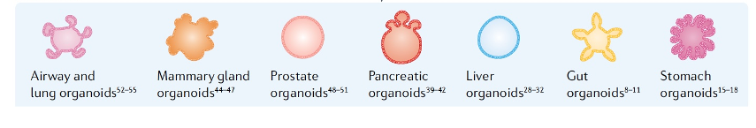
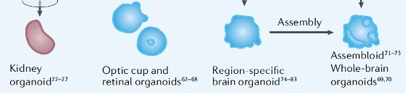
No organ is an island, but is independently "intelligent"
Organoids can be developed from a variety of sources, and embody varied aspects of intelligence
Adapted from https://doi.org/10.1038/s41578-021-00279-y

Slide 9
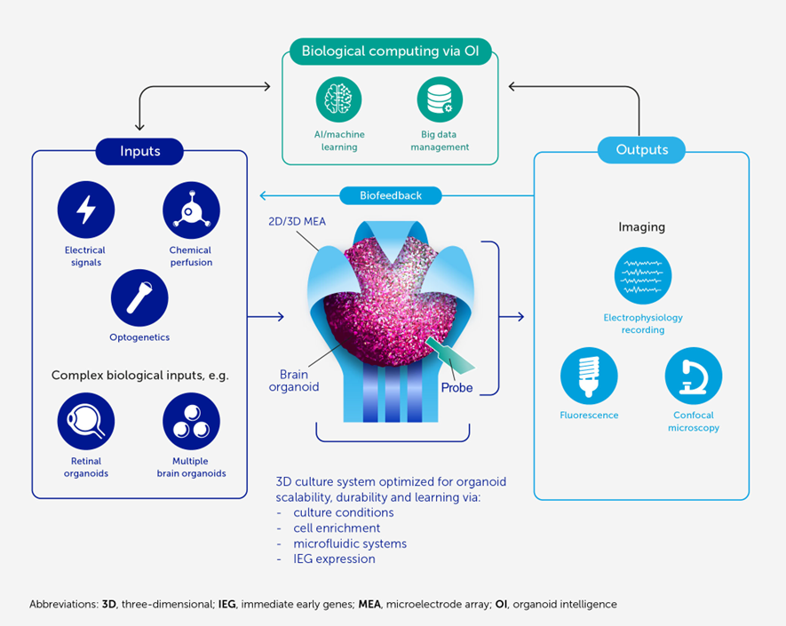
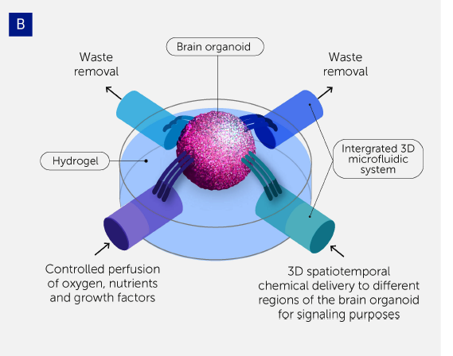
BEGIN OI Research Threads
  Thread 1: Biocomputing Theory and Modeling
  Thread 2: Biology-Integrated Culture Maintenance and Hardware Systems
  Thread 3: Ethical, Legal, and Social Implications (ELSI)
Notes:
Thread 1:
New computational models/AI approaches that describe the ability for storage and retrieval
Effectively interpret the complex biological outputs into meaningful information
Computational strategies may be highly reliant on nature of inputs and outputs; which in turn depends on the sensing and signaling systems employed
Thread 2: To create an organoid-based computer, one must:
Keep it alive and fully functional – this may require, for example, the development of a digital twin of the organoid to effectively control the culture environment
Develop a robust signaling interface that allows for appropriate inputs to be introduced and outputs to be sensed and quantified
Thread 3:
The objective of this thread is to investigate ELSI issues raised by the proposed research project.
Proposals must include a plan within the project description that describes the project’s ELSI research activities.
The plan should identify ELSI research questions that complement the development in Threads 1 and 2. ELSI scholars must be integrated as active collaborators within the research team, helping shape research directions during the lifecycle of the project.

Slide 10

EFRI: Review & Award Process
EFRI Solicitation: NSF 24-508
Required Letters of Intent due on September 12, 2024
Full Proposals are due on December 12, 2024
Notes:
Preliminary Proposal Due Date(s) (required) (due by 5 p.m. submitter's local time):
December 16, 2021
October 13, 2022
Full Proposal Deadline(s) (due by 5 p.m. submitter's local time):
March 10, 2022
February 07, 2023

Slide 11
Personalized Engineering Learning (PEL) Ideas Lab
  Preliminary Proposals:
  Self-nominations to participate in the Ideas Lab via pre-proposal submission.
  Due: November 29, 2023
  Ideas Lab:
  3 days in-person in D.C. Metro area; Week of February 26th, 2024
  3 virtual meetings (half-day);
  March 4th, 6th, 8th, 2024
  Full Proposals:
  Will be invited from some or all of the project teams formed during the Ideas Lab.
  Due: May 8, 2024
  An Ideas Lab is an intensive meeting that brings together multiple diverse perspectives to focus on finding innovative cross-disciplinary solutions to a grand challenge problem.
  The goal of the Personalized Engineering Learning Ideas Lab is to extend engineering education research to enable advanced personalization in pedagogy and assessment in a K-12 or higher education context.
  The following broad areas have been identified as possible avenues to advance knowledge:
  Personalized engineering education
  Multimodal sensing for personalized learning systems
  Team-based personalized learning.
NSF 23-627

Slide 12



NSF Trailblazer Engineering Impact Award
Individual researchers
  Engineer – all disciplines
  Demonstrated research excellence
  Record of creativity and innovation
  Record of paradigm-shifting outcomes
Projects
  Shift in fundamental engineering knowledge
  Address a major societal challenge
  New research direction for the PI
  Integrate research and broader impacts
Review Process – Panels and Interviews

Slide 13

Mission:
To identify and develop bold and transformative new engineering research directions and thereby catalyze the engineering community’s pursuit of innovative, high-impact research that benefits society.
Mechanism:
5-year award from the NSF Directorate for Engineering
Component organizations:
  Big Ten Academic Alliance, EPSCoR/IDeA Foundation, University-Industry Demonstration Partnership
ERVA visioning events convene experts to focus on individual themes
Notes:
Funded by the National Science Foundation (NSF) Directorate for Engineering, ERVA was launched in April of 2021. The five-year initiative convenes, catalyzes and empowers the engineering community to identify nascent opportunities and priorities for engineering-led innovative, high-impact, cross-domain research that addresses national, global and societal needs.
ERVA is a diverse, inclusive and engaged partnership that enables an array of voices to impact national research priorities. We seek to provide the engineering community with a process for identifying bold and high-impact engineering research directions that will place the U.S. in a leading position to realize a better future for all.
Engineering research is foundational to many of the products and services that we currently depend upon and look forward to having in the future. ERVA will help our nation stay at the forefront of innovation in engineering research and practice by identifying and developing new, high-impact engineering research directions to help the engineering community solve challenges and improve daily life. These visioning efforts will play a critical role in identifying opportunities that can be effectively translated to provide real-world positive impact to society.

Slide 14
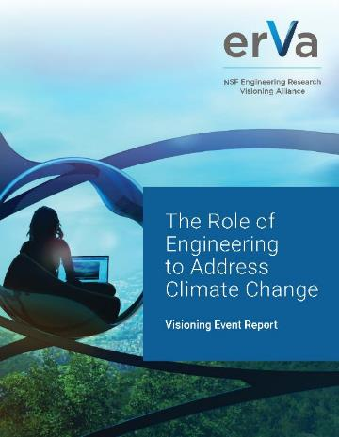
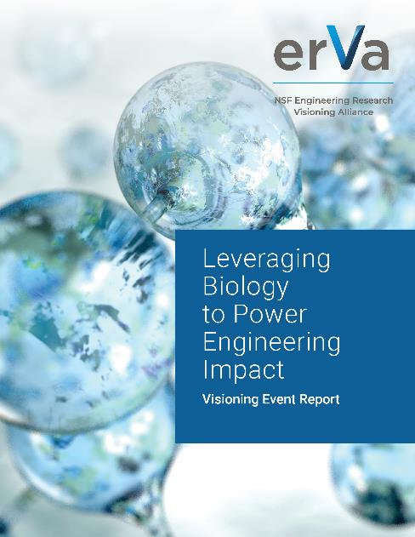
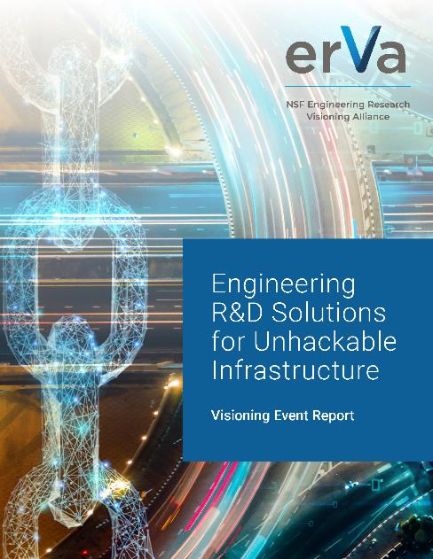
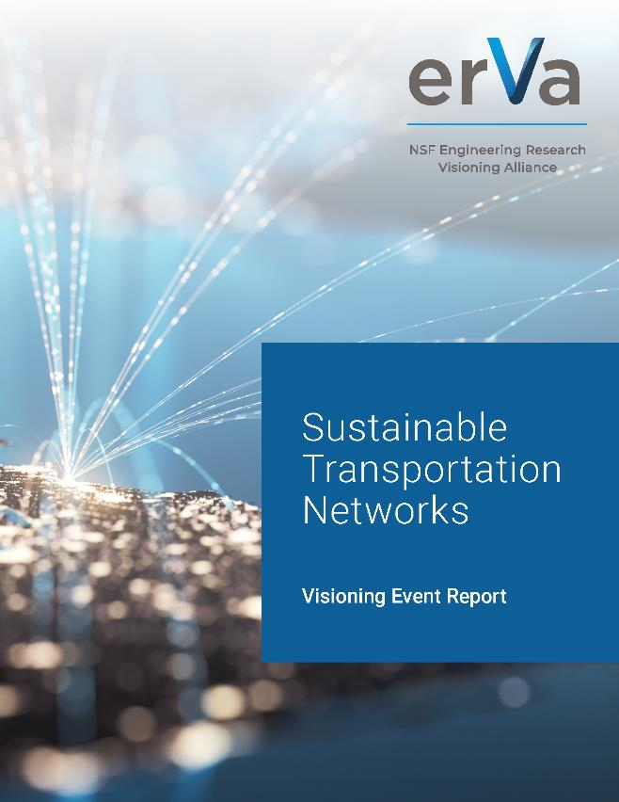



ERVA Visioning Reports
Aug. 17, 2022
Oct. 27, 2022
Feb. 16, 2023
April 26, 2023
July 13, 2023
October 12, 2023
ervacommunity.org
Notes:
ERVA has published reports from seven events to date that identify engineering priority research directions to address the themes of climate change, leveraging biology to power engineering impact, unhackable infrastructure, sustainable transportation, solutions for water security, and engineering the future of distributed manufacturing. One not shown on the slide discusses Engineering Materials for a sustainable future.
You can download these reports using the QR codes at the bottom. They’re also on the ERVA website, ervacommunity.org, under the “News” tab.

Slide 15

Get Involved!
  Click to become
  an ERVA Champion!
  Follow the ERVA community:
    ERVAcommunity.org
    @ERVAcommunity
    #ERVAcommunity
    info@ervacommunity.org
Notes:
Opportunities for involvement include participation in visioning events as well as in the thematic task forces that shape them. Additionally, ERVA regularly solicits ideas for themes for future visioning events through open calls.
Use this QR code to sign up to be an ERVA Champion!

